Slide 1
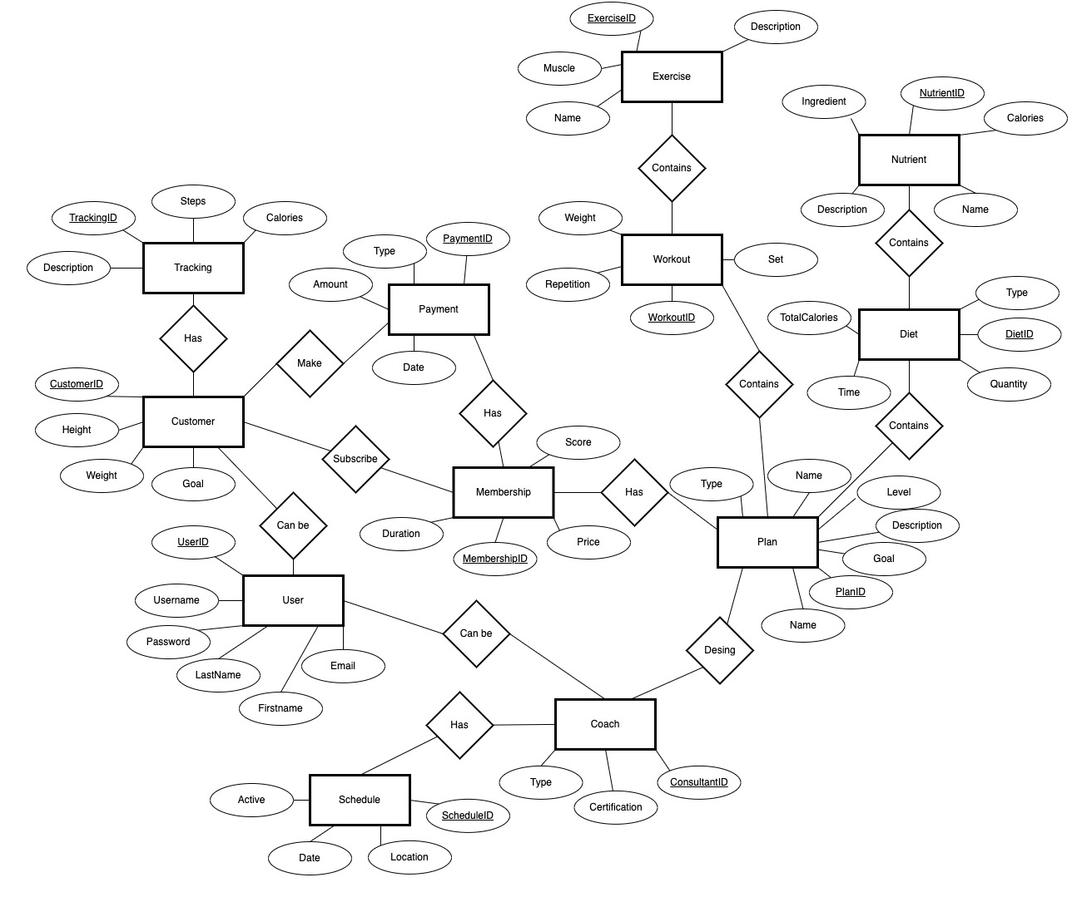
Conceptual ER Diagram Health Application

Slide 2
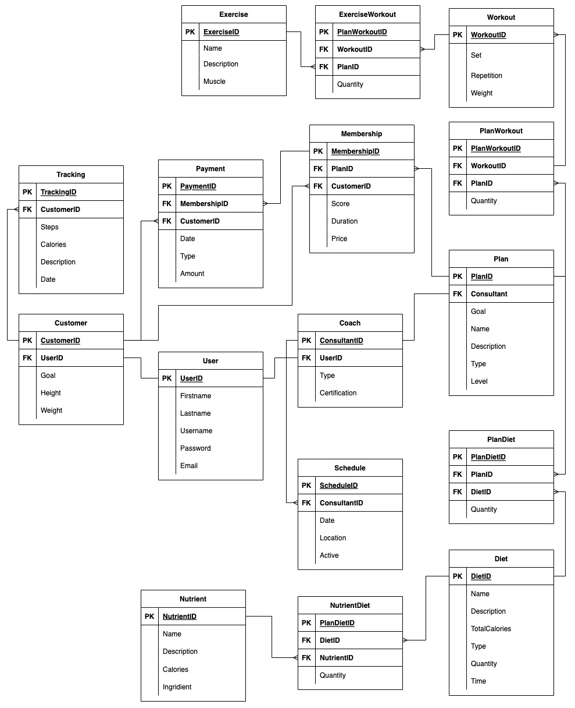
Logical ER Diagram Health Application

